Slide 1

The Parents’ Guide to
Google Classroom
Notes:
Original Document credit Mr. Vacca from Mohonasen High School
https://www.youtube.com/watch?v=2Iowi-gmbys

Slide 2
What is
Google Classroom?
Think of Google Classroom
as your child’s digital link to learning.
Teachers use Google Classroom to share learning activities, home learning, newsletters, and much more with students AND parents!

Slide 3
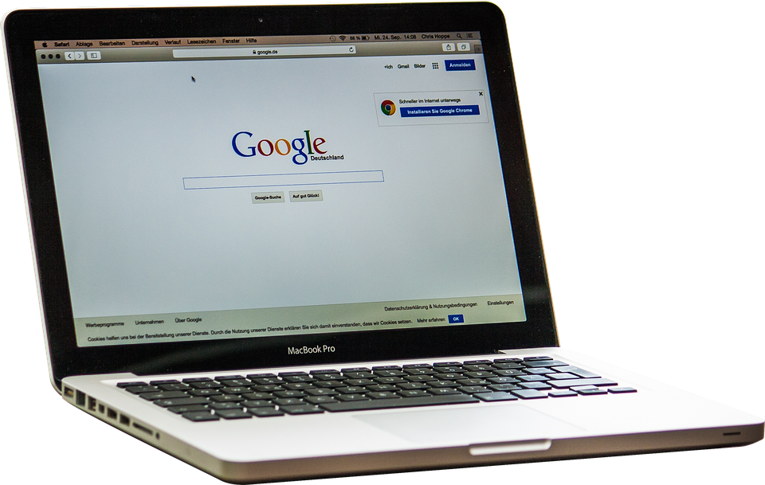
Getting Started
Your child was provided with a secure login and password that is unique to them –
these are in their reading records.
Check with your child’s teacher via Dojo to obtain this private information.

Slide 4


Getting Started
Click on the Google Chrome browser icon.

Slide 5


Getting Started
Type www.google.com into your web
address bar.

Slide 6

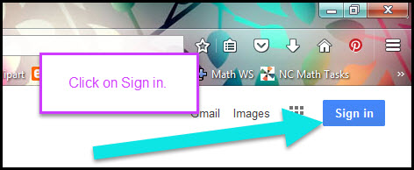
Getting Started
Click on SIGN IN in the upper right hand corner of the browser window.

Slide 7
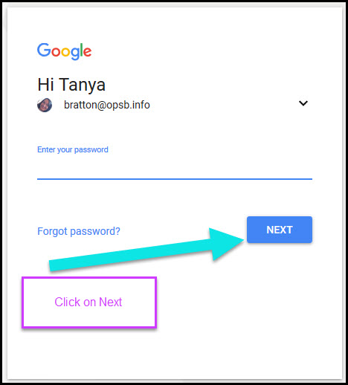

Getting Started
Type in your child’s Google Email address
(studentid@berrywoodprimary.co.uk) & click “next.”
Your child’s Google Classroom login is made up of the last two digits of the year they started with us at Berrywood followed by their first initial and then their surname.

Slide 8

Getting Started
Type in your PASSWORD
& click “next.”

Slide 9
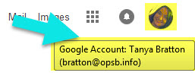
Now you’ll see
that you are signed in to your Google Apps for Education account!
Google Account email:
studentid@csdnbstudents.org

Slide 10
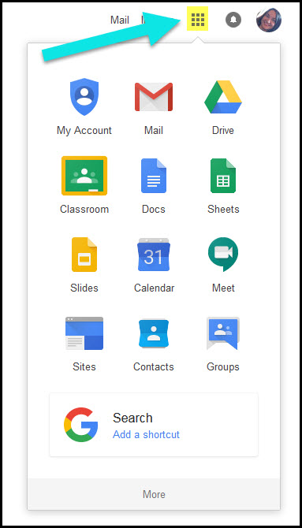
Google
suite
Click on the 9 squares
(Waffle/Rubik’s Cube) icon in the
top right hand corner to see
the Google Suite of Products!

Slide 11
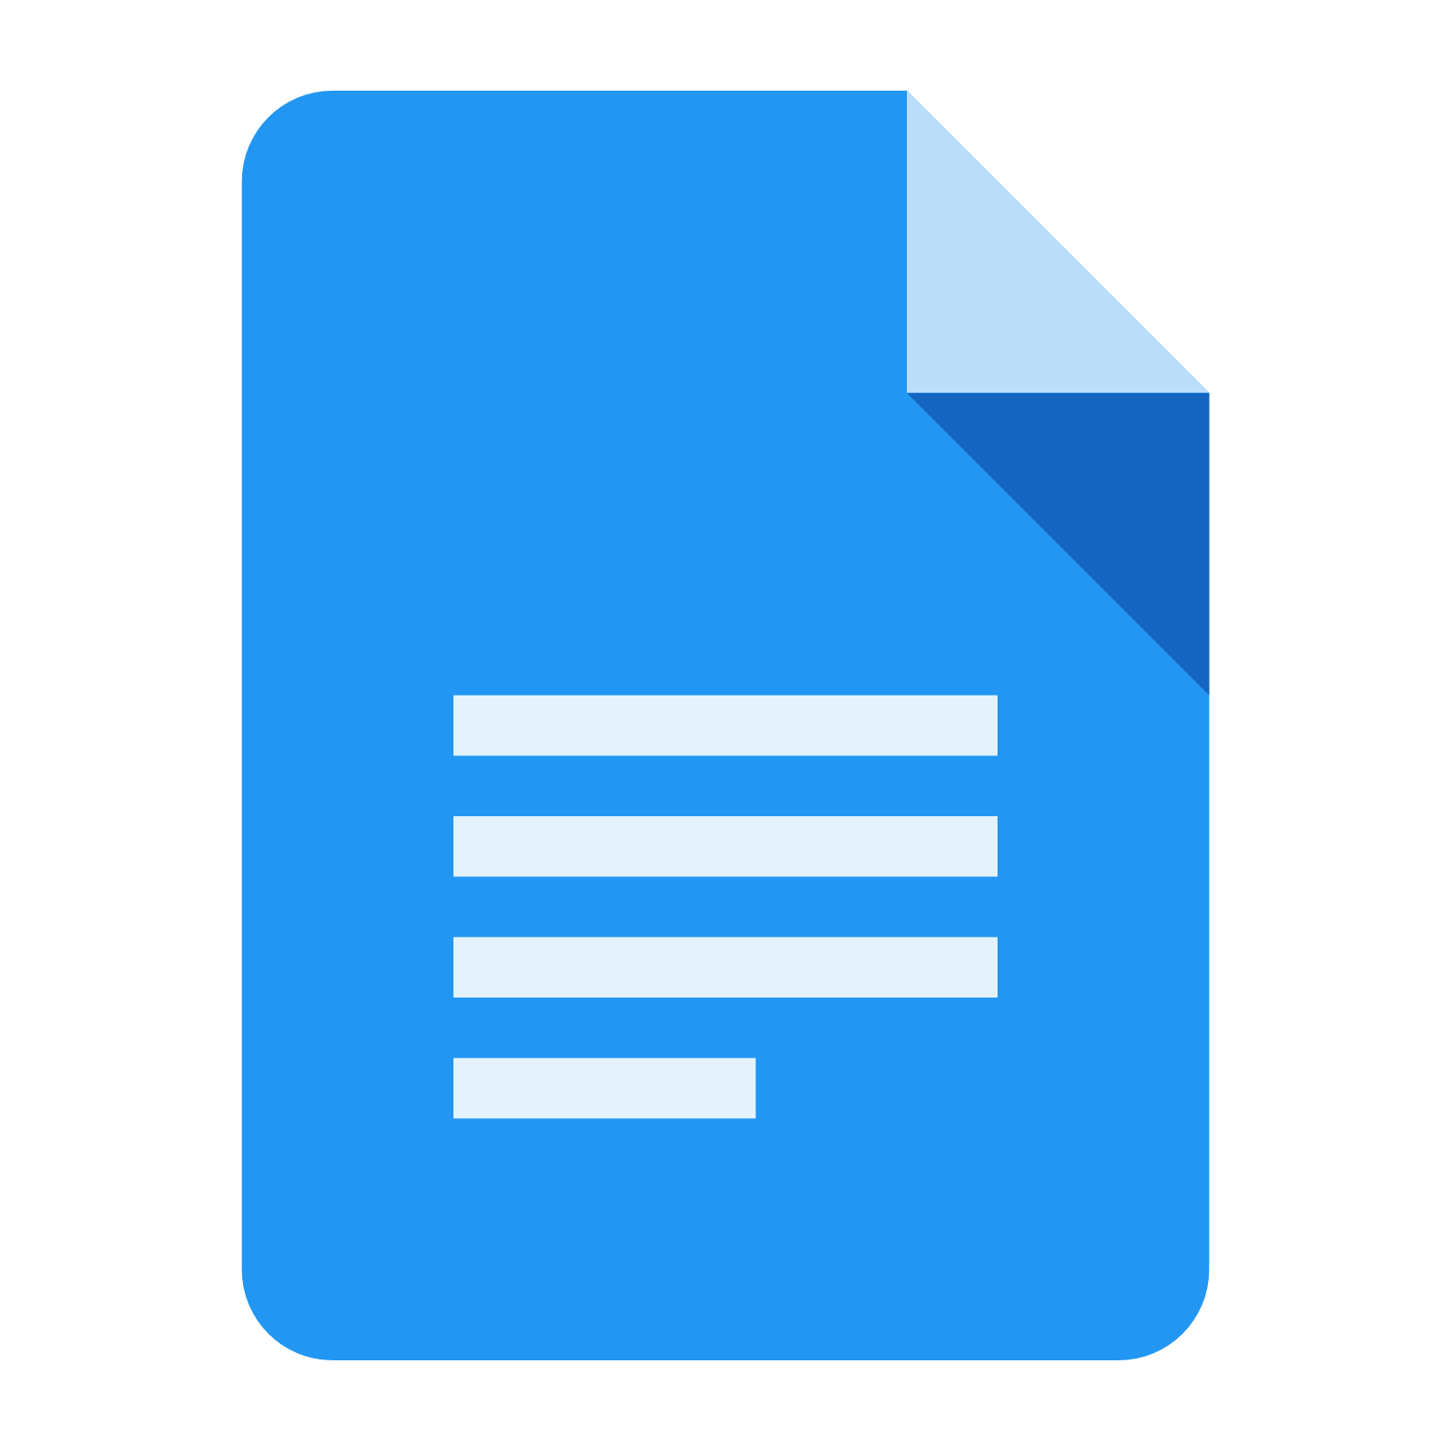


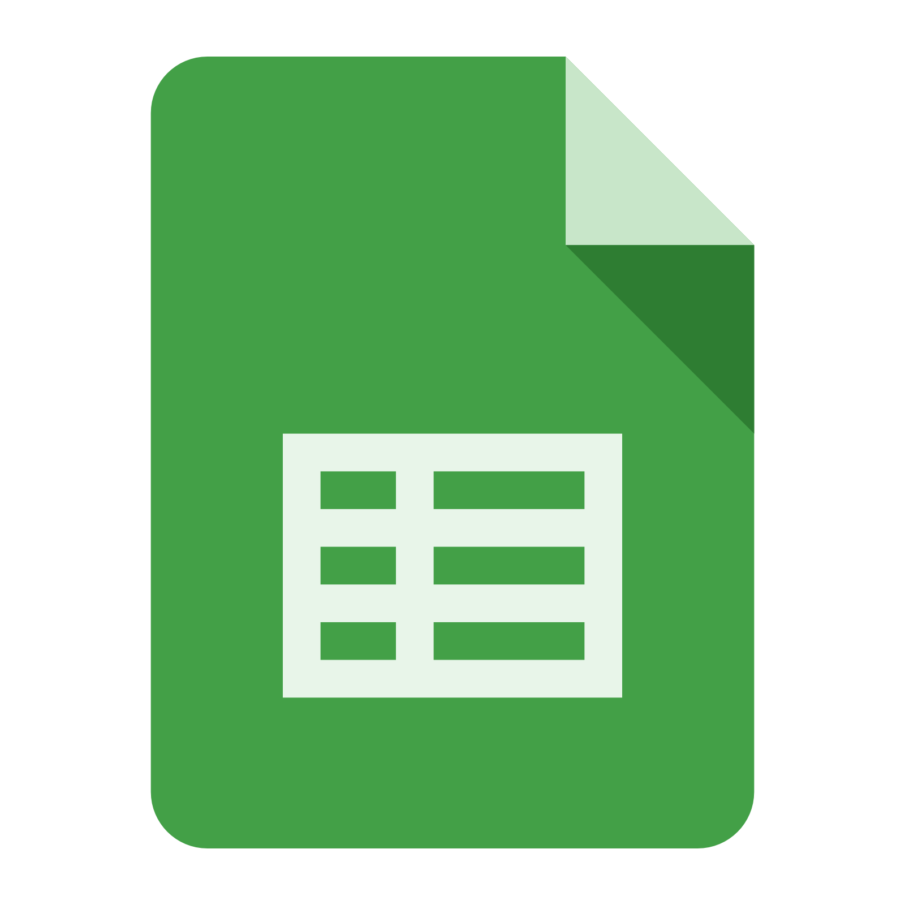
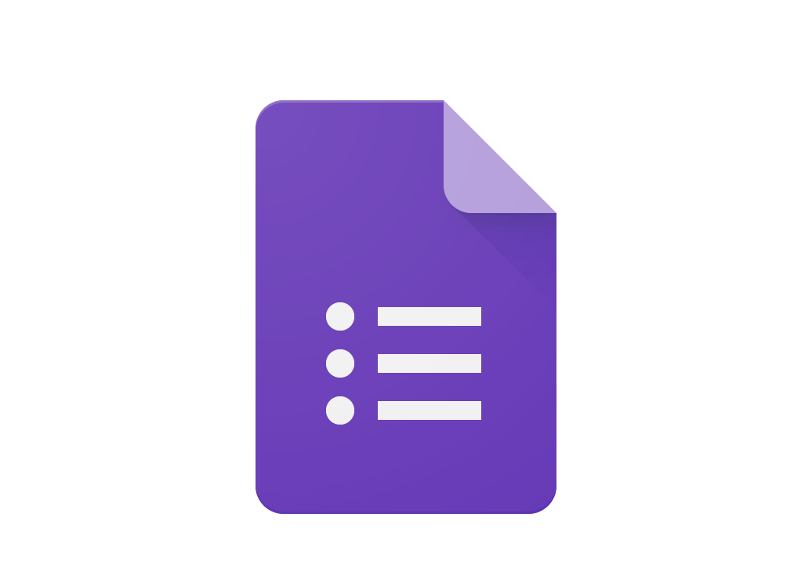
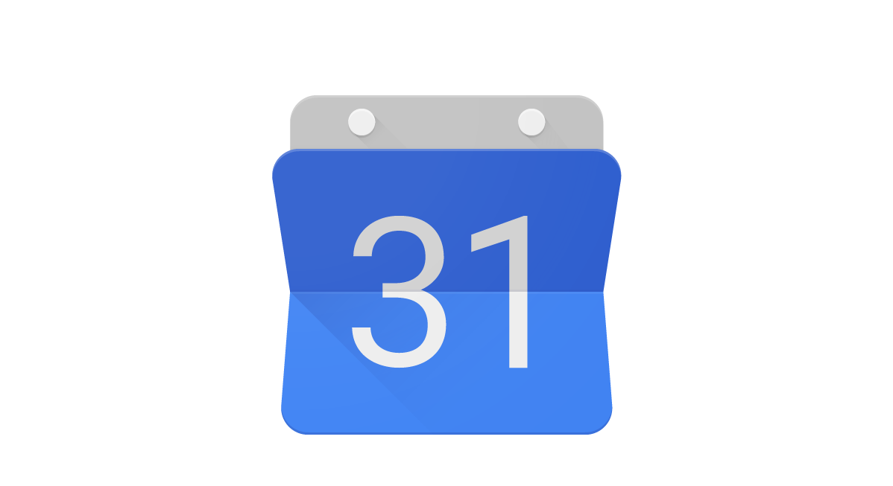
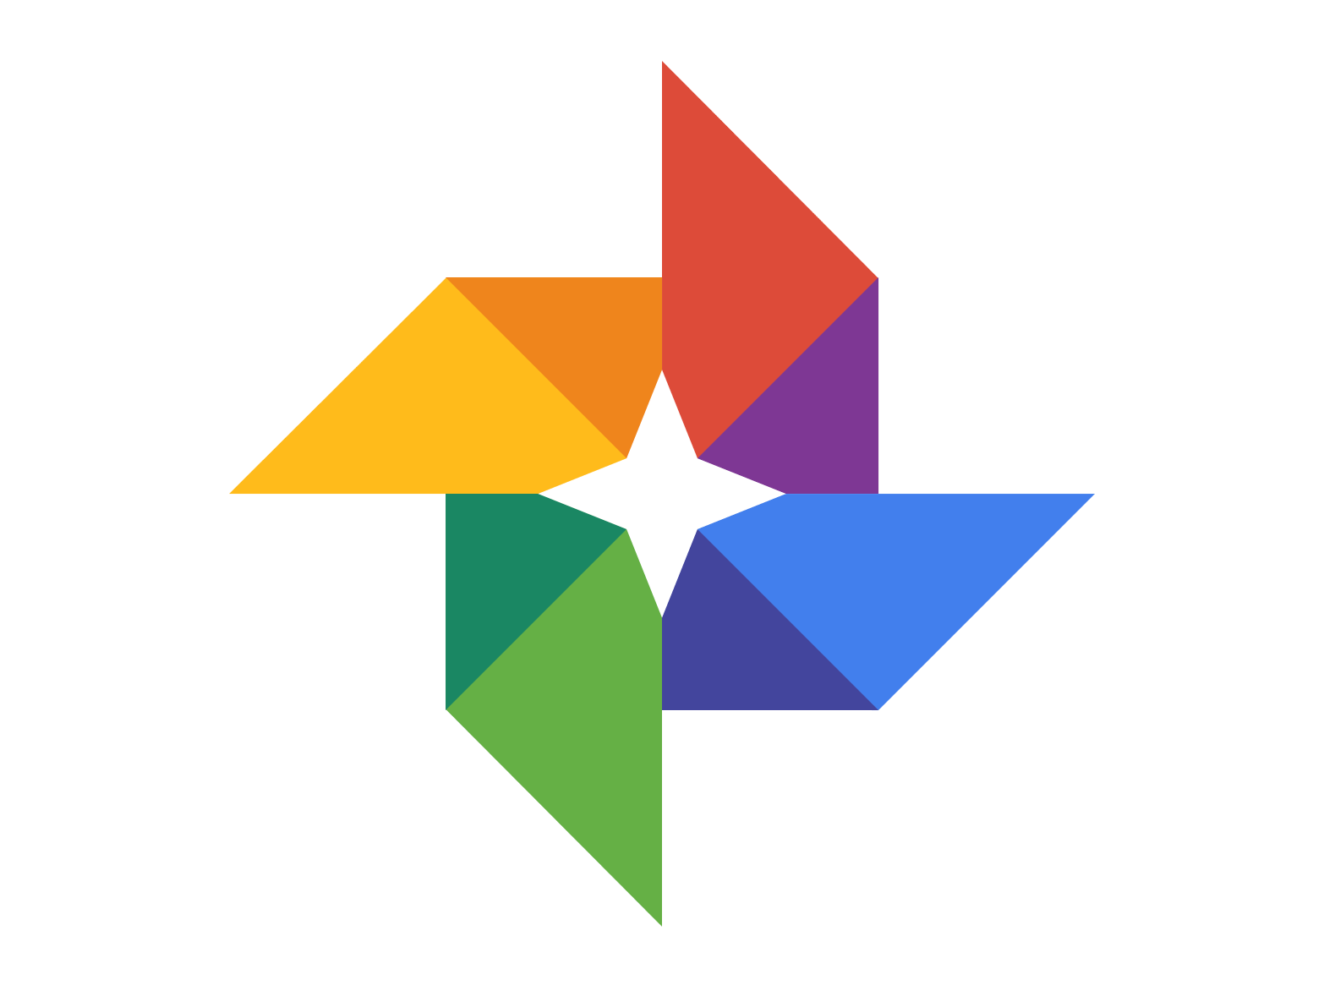
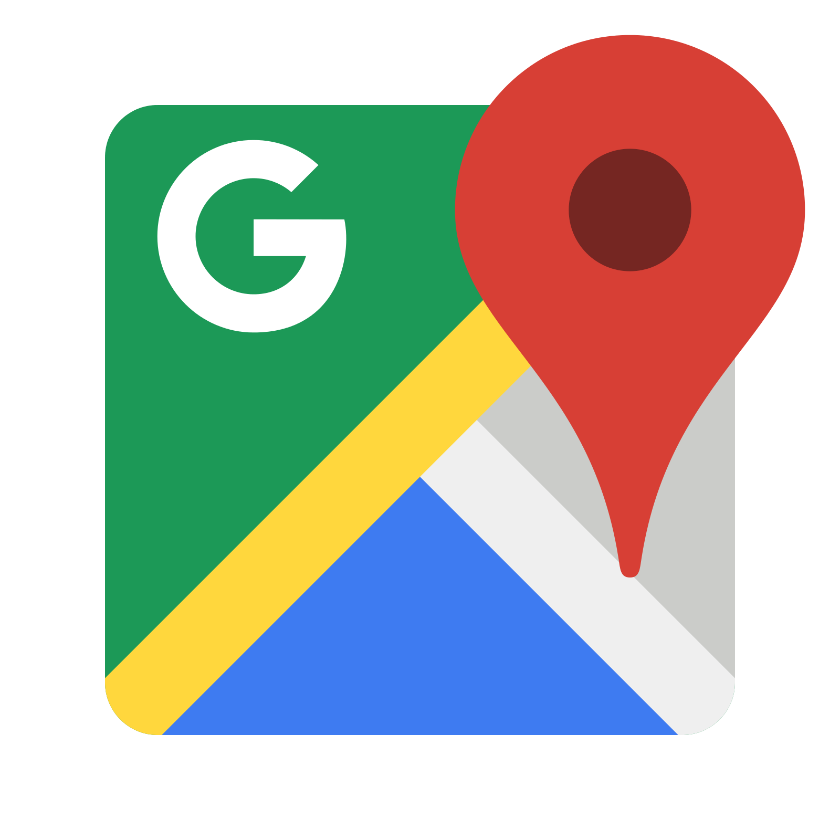

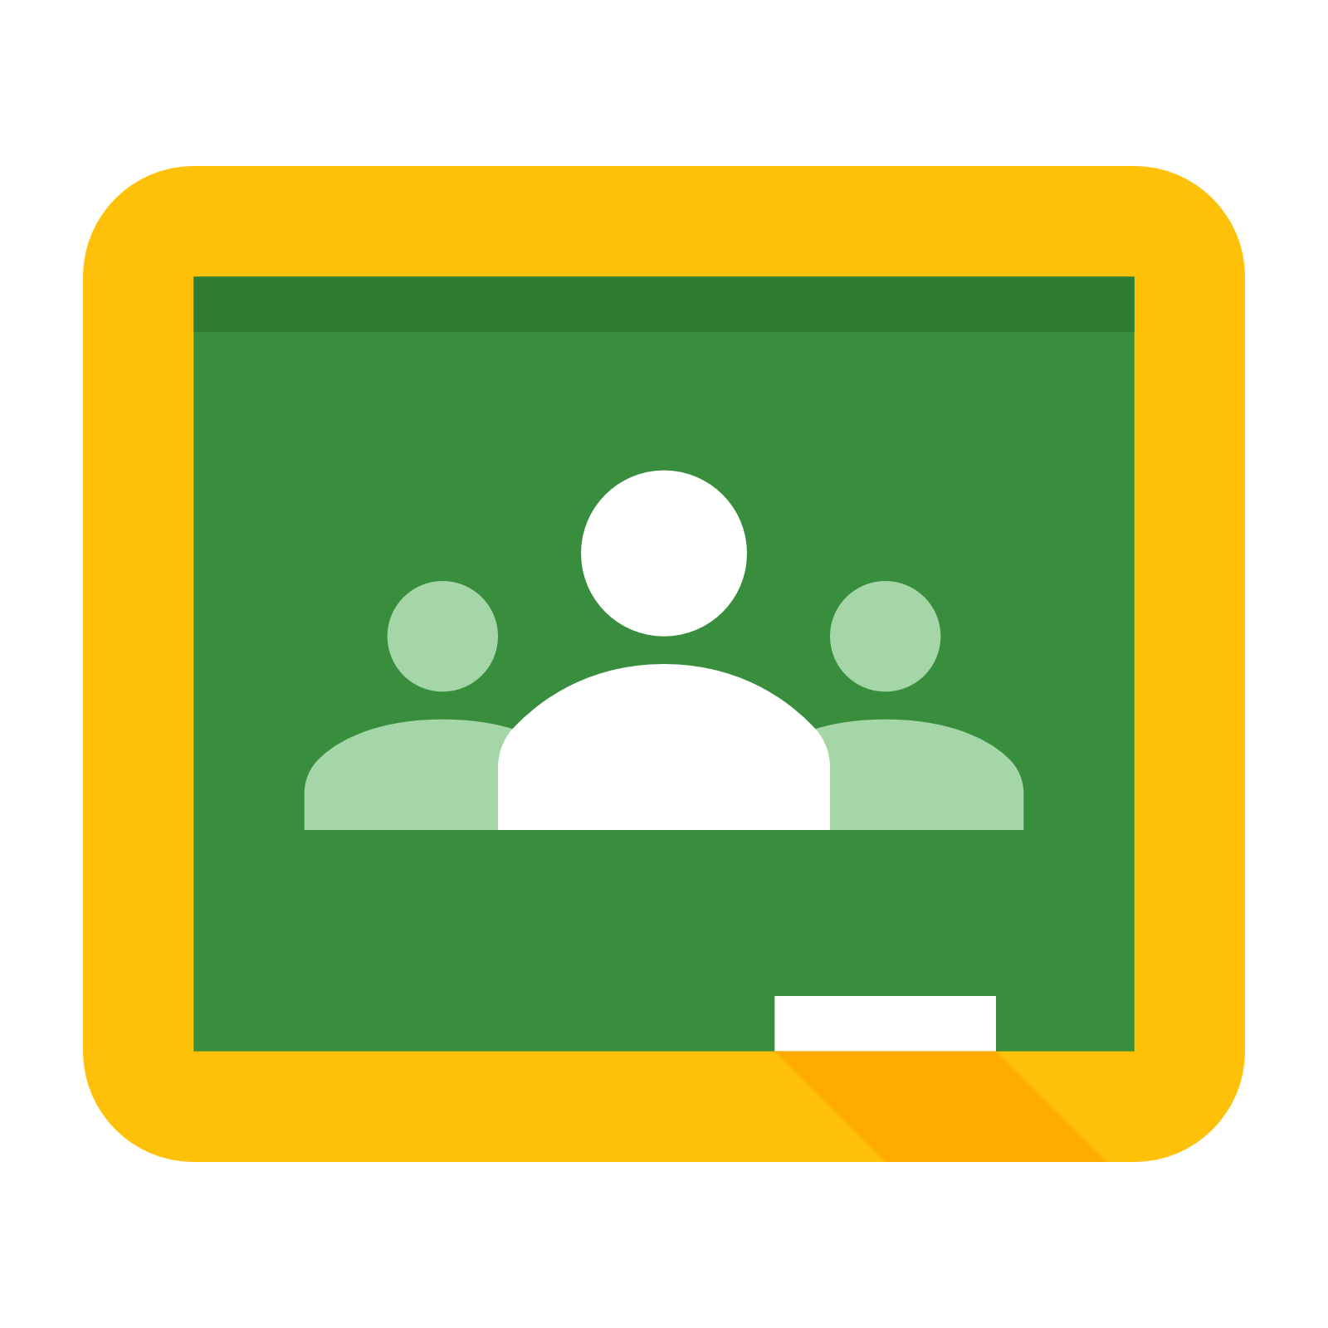


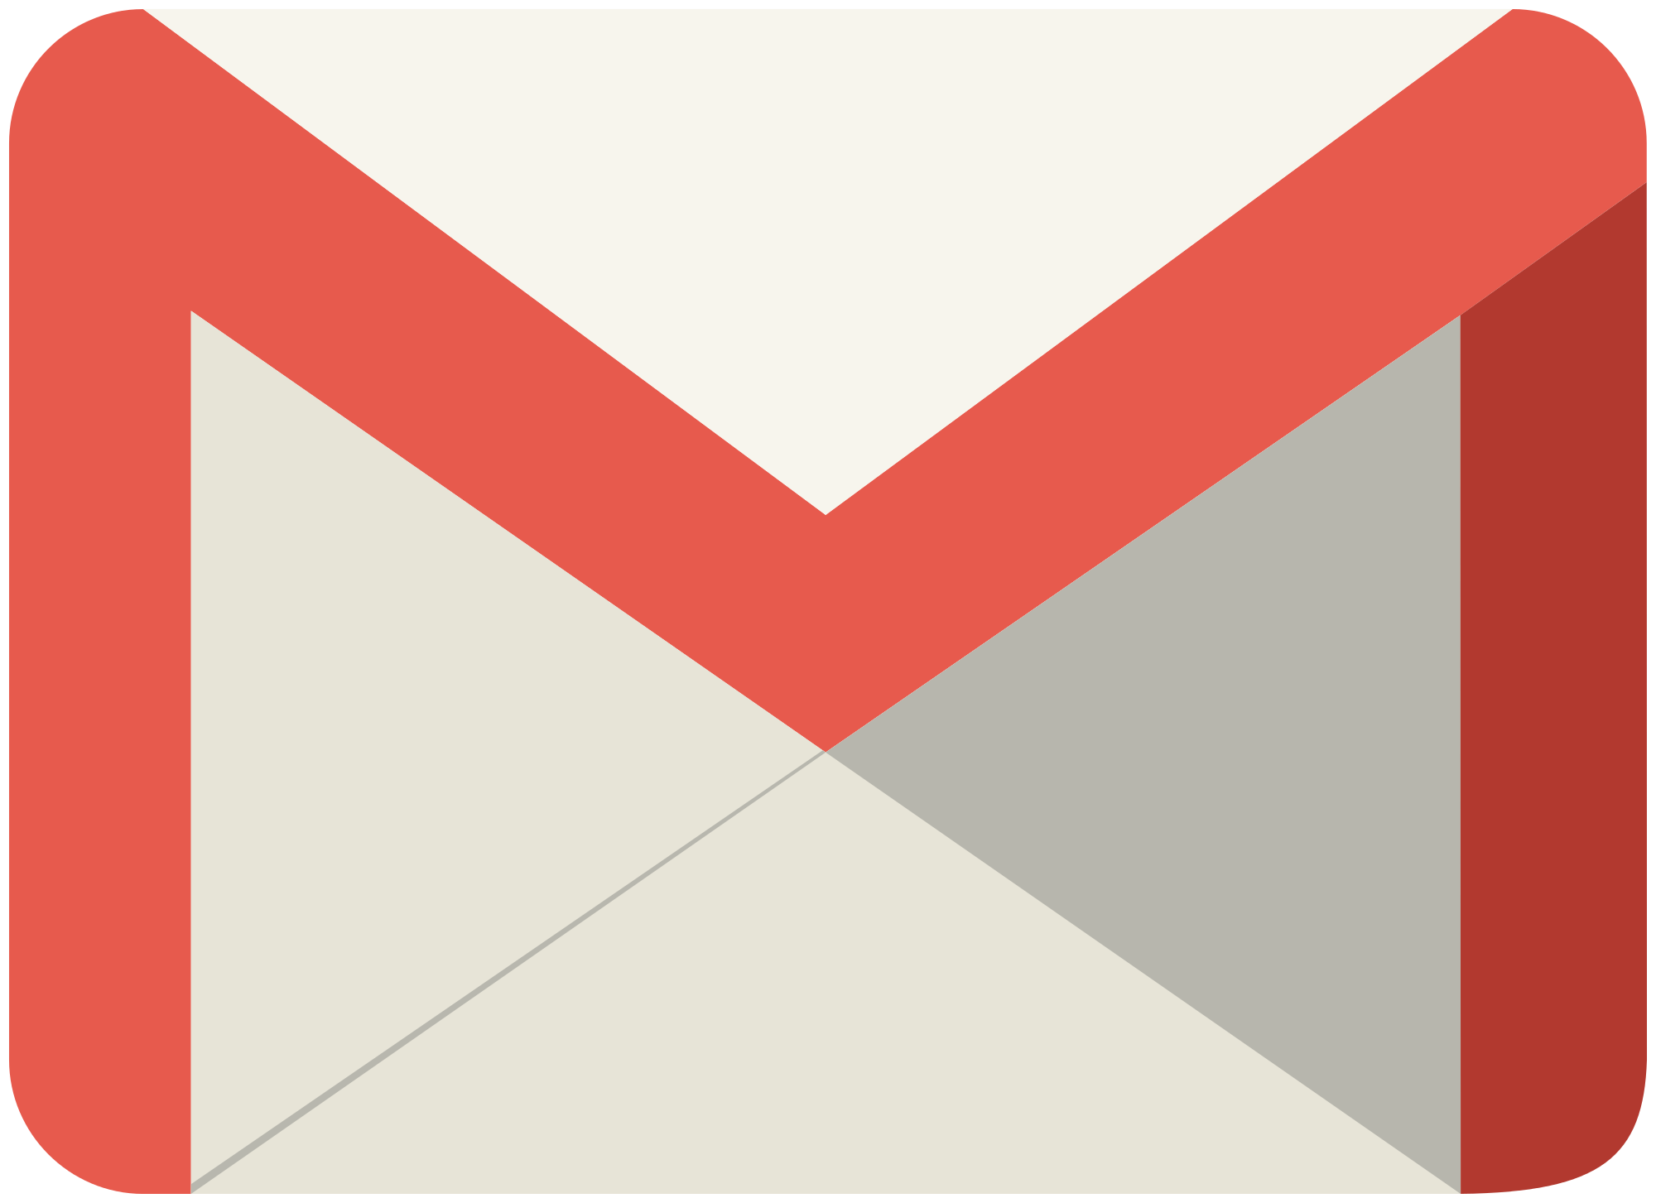



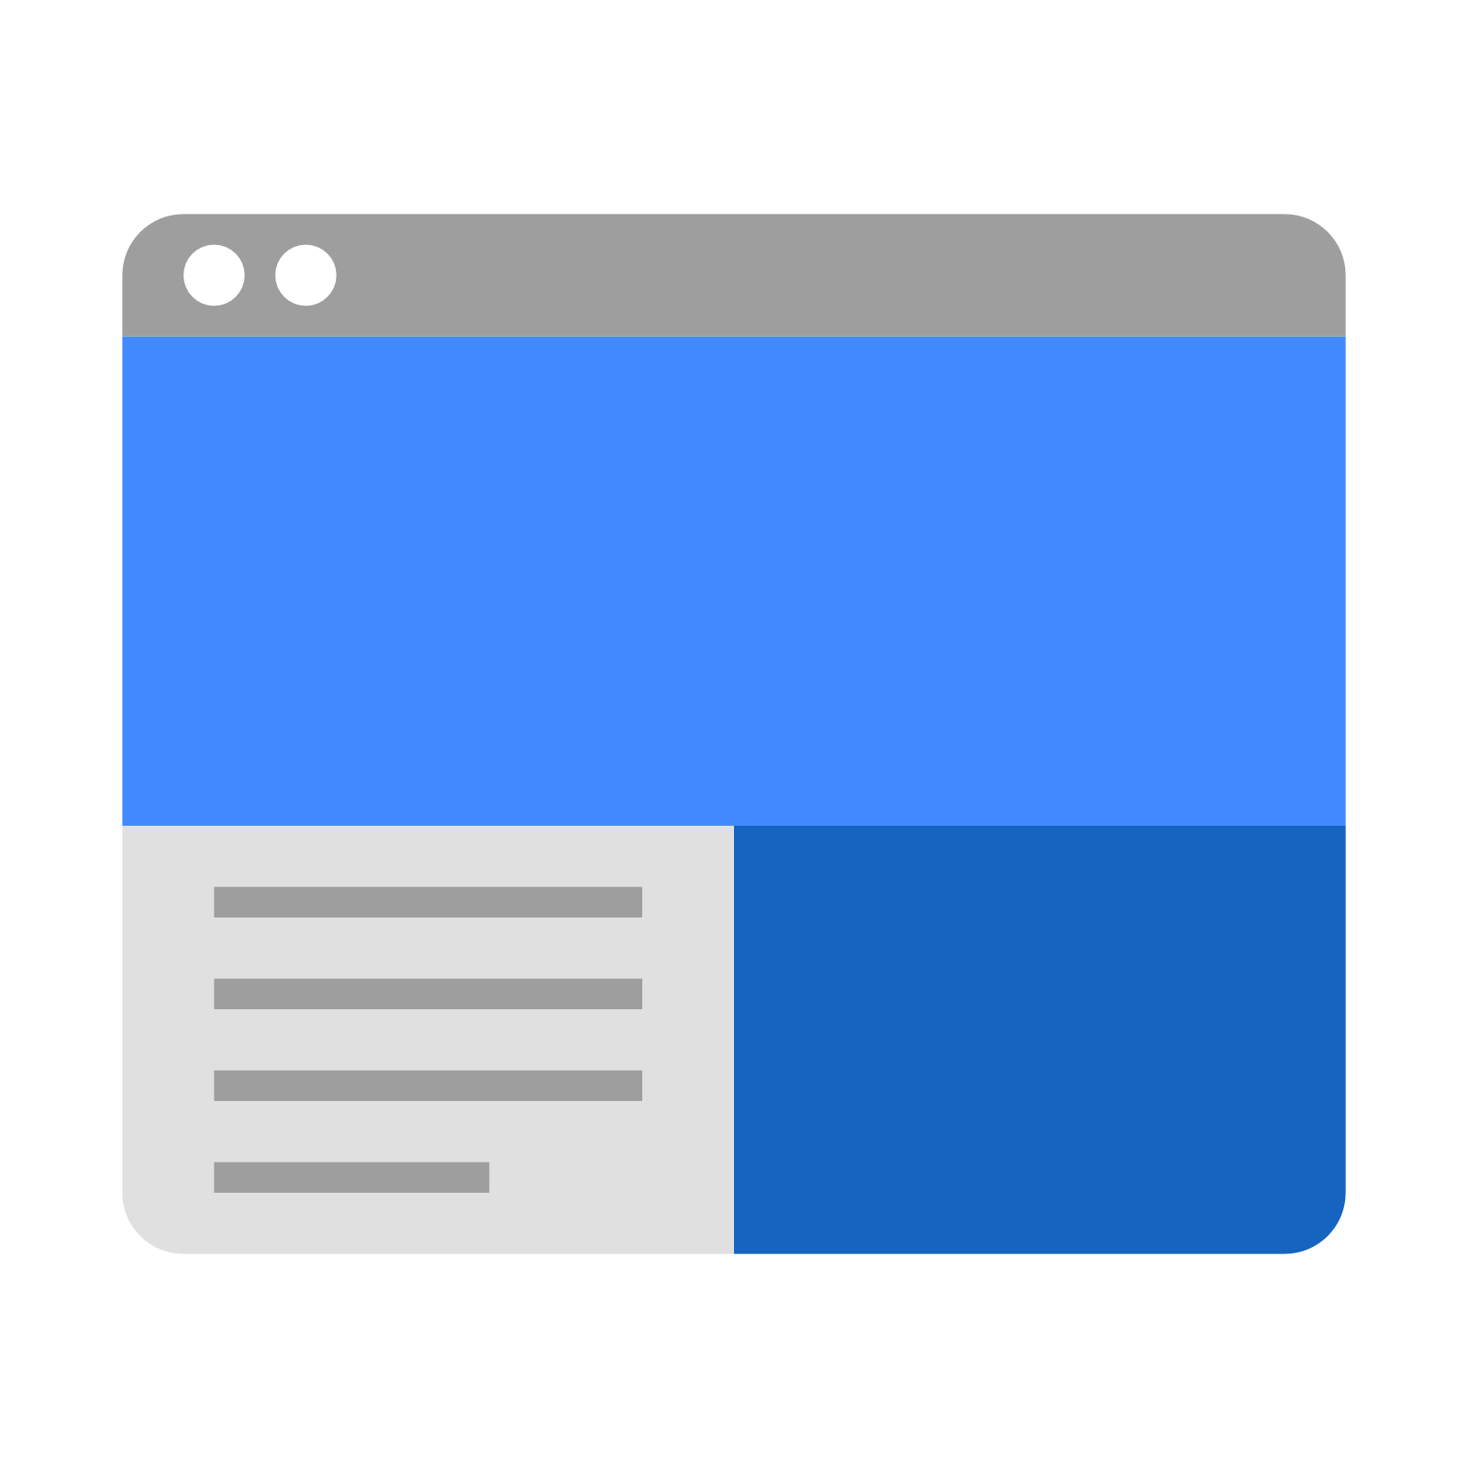
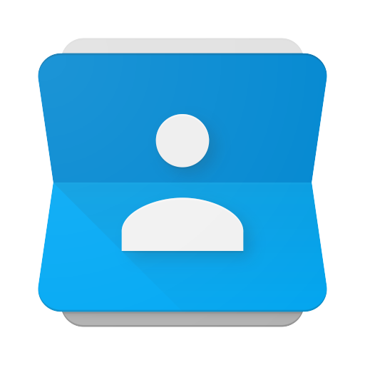
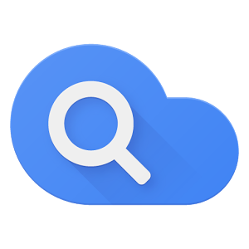



GOOGLE ICONS to recognise:
CHROME DOCS DRIVE SLIDES SHEETS FORMS CALENDAR
GMAIL PHOTOS MAPS KEEP CLASSROOM MEET HANGOUTS
SITES CONTACTS CLOUD CLOUD SEARCH YOUTUBE NEWS VAULT
MY ACCOUNT GROUPS

Slide 12
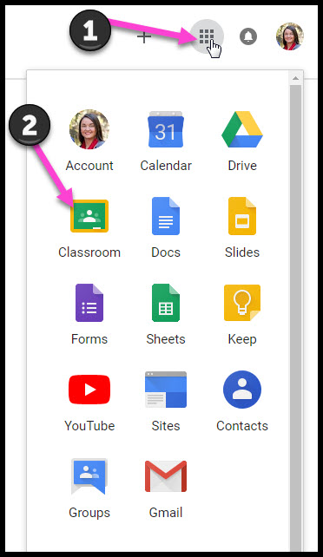
Navigating Classroom
Click on the 9 squares button and then the
Google Classroom icon.

Slide 13
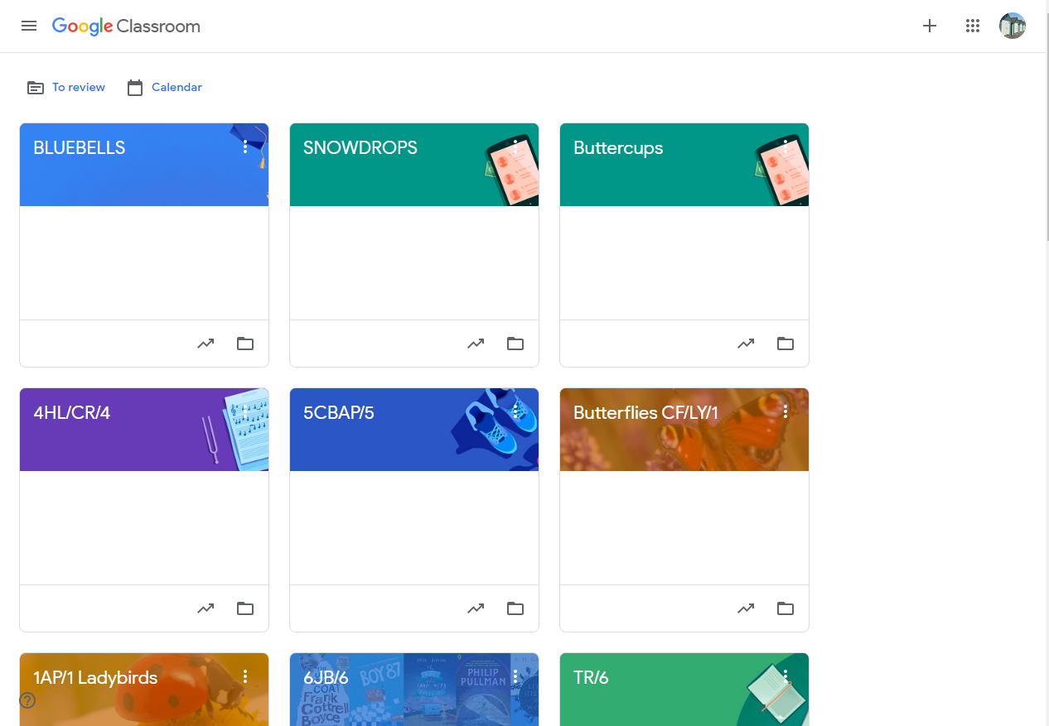
Navigating Classroom
Click on your child’s classroom name.

Slide 14

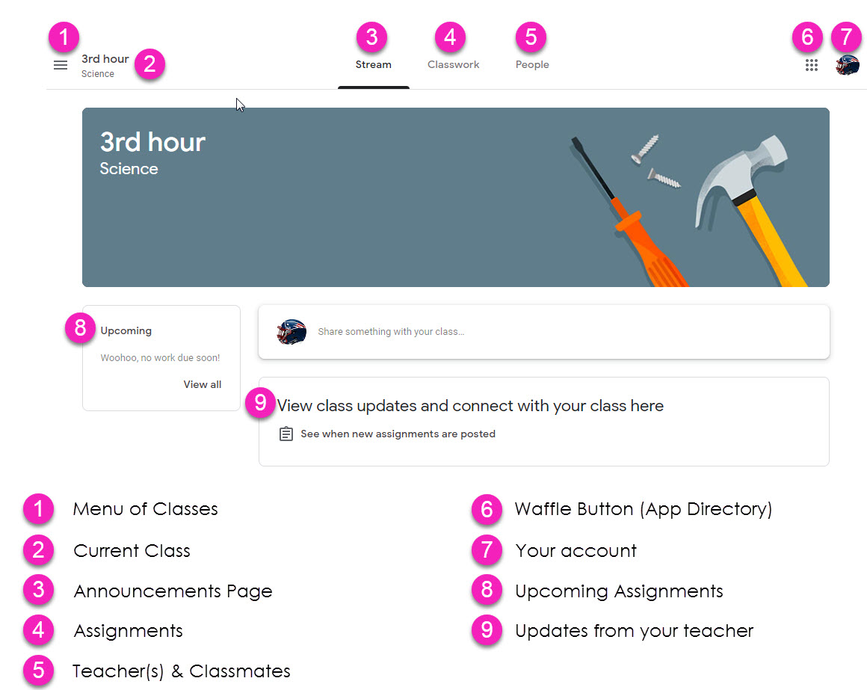
Navigating Classroom
= High Interest for Parents
Page tools
(Left side)

Slide 15
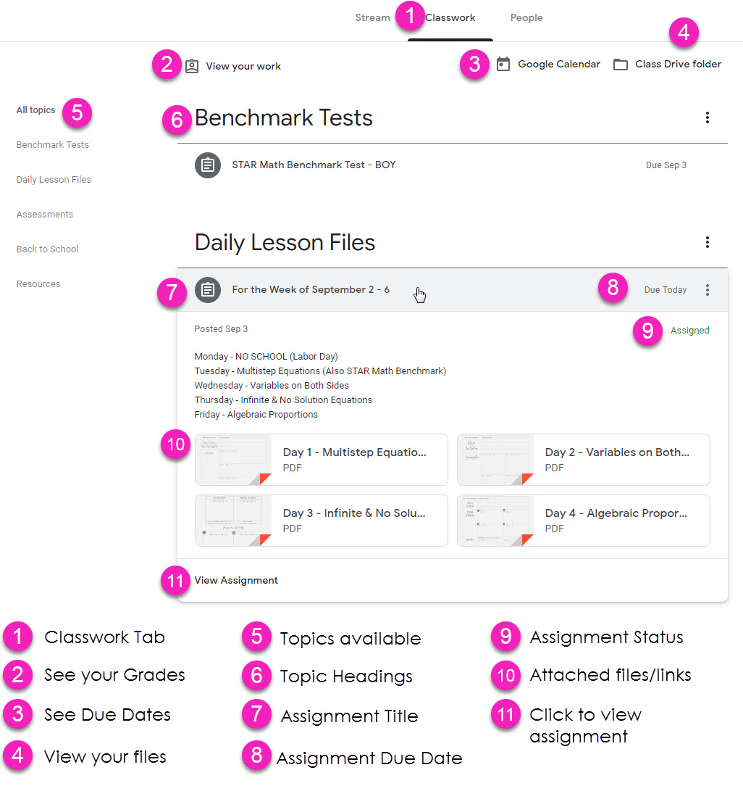
Navigating Classroom
Assignment details

Slide 16

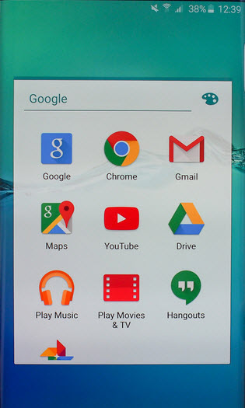
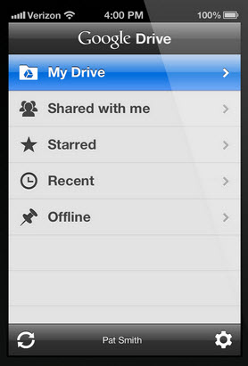
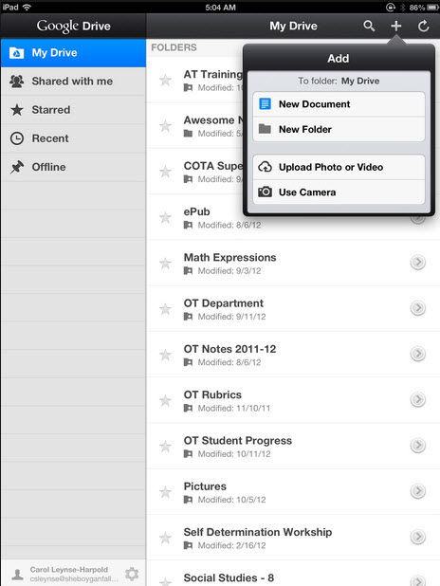
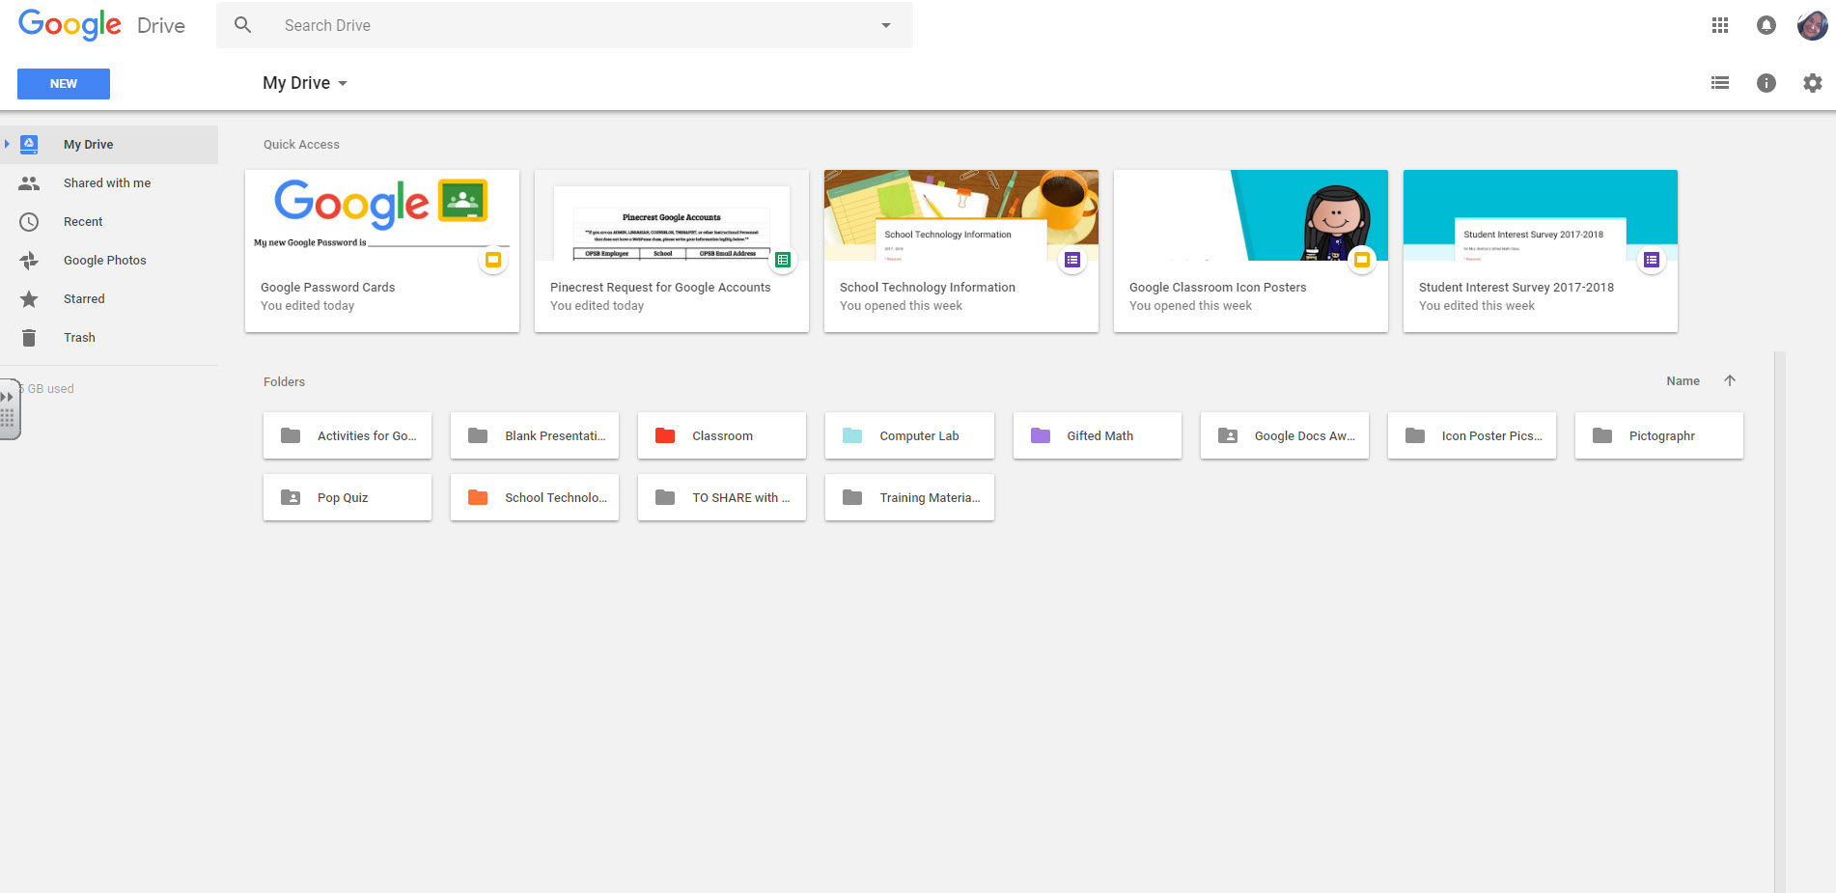
access
anywhere
Android
Iphone
Tablet
desktop

Slide 17


GOOGLE APPS
allow you to edit Google applications from
any device that is connected to the internet!

Slide 18
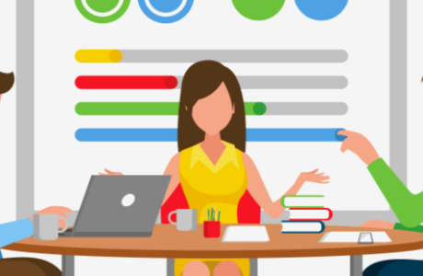
questions?
Email us at:
office@berrywoodprimary.co.uk
Or:
DOJO your class teacher

